Slide 1
Gestão da diversidade
5

Slide 2
objectivos
Definir o que é diversidade no local de trabalho e porque é que a sua gestão é importante.
Explicar os diferentes tipos de diversidade no local de trabalho.
Descrever os desafios que os gestores enfrentam na gestão da diversidade.
Descrever as diversas iniciativas de gestão da diversidade.

Slide 3
O que é a Diversidade nas organizações?
Diversidade nas organizações
Modo como as pessoas de uma organização são diferentes, ou semelhantes, umas das outras.
Notes:
Diversity has been “one of the most popular business topics over the last two decades.” It ranks with modern business disciplines such as quality, leadership, and ethics. Despite this popularity, it’s also one of the most controversial and least understood topics. With its basis in civil rights legislation and social justice, the word diversity often invokes a variety of attitudes and emotional responses in people.
So, what’s our definition of workplace diversity? We’re defining it as the ways in which people in an organization are different from and similar to one another. Notice that our definition not only focuses on the differences, but the similarities, of employees. This reinforces our belief that managers and organizations should view employees as having qualities in common as well as differences that separate them.

Slide 4
O que é a Diversidade nas organizações? (Cont)
Diversidade superficial
Diferenças facilmente percebidas e que podem dar origem a estereótipos, mas que não refletem necessariamente os pensamentos e sentimentos das pessoas.
Diversidade
acentuada
Diferenças em valores, personalidade, e preferências quanto às práticas de trabalho.
Notes:
The demographic characteristics that we tend to think of when we think of diversity—age, race, gender, ethnicity, and so on—are just the tip of the iceberg. These demographic differences reflect surface-level diversity, which are easily perceived differences that may trigger certain stereotypes but that do not necessarily reflect the ways people think or feel. Such surface-level differences in characteristics can affect the way people perceive others, especially when it comes to assumptions or stereotyping.
As people get to know one another, these surface-level differences become less important and deep-level diversity—differences in values, personality, and work preferences—becomes more important. These deep-level differences can affect the way people view organizational work rewards, communicate, react to leaders, negotiate, and generally behave at work.

Slide 5
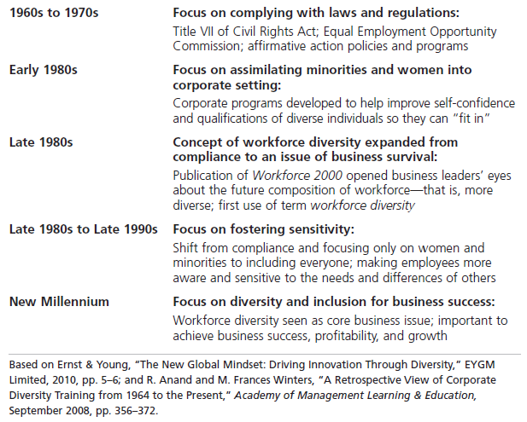
figura 5-1 história da evolução da Diversidade
Notes:
Diversity has traditionally been considered a term used by human resources departments, associated with fair hiring practices, discrimination, and inequality. But diversity today is considered to be so much more. Exhibit 5-1 illustrates an historical overview of how the concept and meaning of workforce diversity has evolved.

Slide 6
Porque é importante gerir a diversidade nas organizações?
Gestão das pessoas
Desempenho organizacional
Interesse estratégico
Notes:
Diversity is, after all, about people, both inside and outside the organization. The people management benefits that organizations get because of their workforce diversity efforts revolve around attracting and retaining a talented workforce.
Performance benefits that organizations get from workforce diversity include cost savings and improvements in organizational functioning. The cost savings can be significant when organizations that cultivate a diverse workforce reduce employee turnover, absenteeism, and the chance of lawsuits.
Organizations also benefit strategically from a diverse workforce. You have to look at managing workforce diversity as the key to extracting the best talent, performance, market share, and suppliers from a diverse country and world. One important strategic benefit is that with a diverse workforce, organizations can better anticipate and respond to changing consumer needs. Diverse employees bring a variety of points of view and approaches to opportunities, which can improve how the organization markets to diverse consumers.

Slide 7
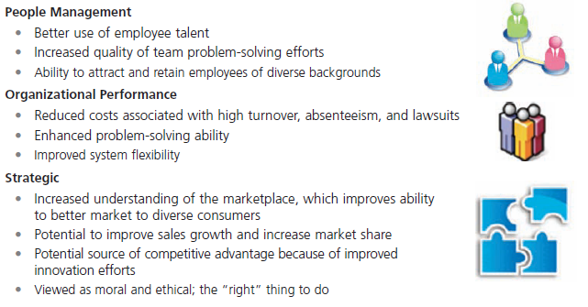
figura 5-2
Benefícios da Diversidade
Notes:
Many companies are experiencing the benefits that diversity can bring. Exhibit 5-2 looks at why workforce diversity is so important to organizations. The benefits fall into three main categories: people management, organizational performance, and strategic.

Slide 8
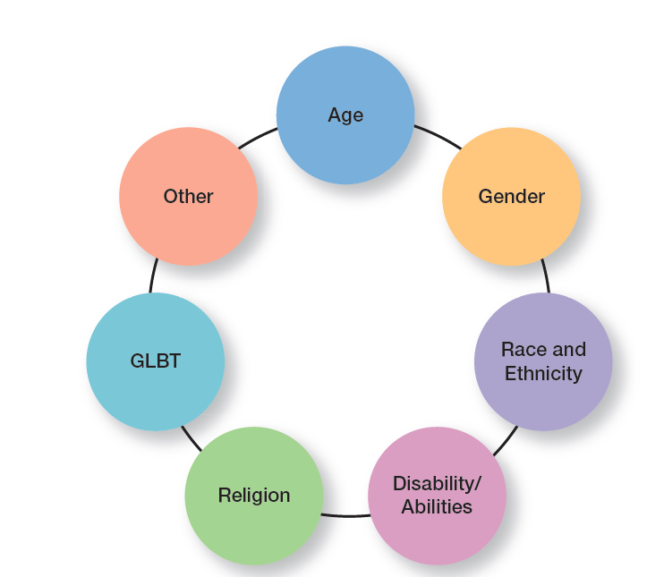
Exhibit 5-5
Types of Diversity Found in Workplaces
Notes:
Diversity is a big issue, and an important issue, in today’s workplaces. What types of dissimilarities—that is, diversity—do we find in those workplaces? Exhibit 5-5 shows several types of workplace diversity.

Slide 9
Tipos de diversidade nas organizações
Idade
Género
Raça
Etnia
Deficiência
Religião
Orientação / Identificação
Outros tipos de diversidade
Notes:
The aging population is a major critical shift taking place in the workforce. With many of the nearly 85 million baby boomers still employed and active in the workforce, managers must ensure that those employees are not discriminated against because of age. Both Title VII of the Civil Rights Act of 1964 and the Age Discrimination in Employment Act of 1967 prohibit age discrimination.
Women (49.8%) and men (50.2%) now each make up almost half of the workforce. Yet, gender diversity issues are still quite prevalent in organizations. Take the gender pay gap. The latest information on the ratio of women’s to men’s median weekly earnings showed the figure at 80.2; the ratio for median annual earnings stood at 77.1. It’s important for organizations to explore the strengths that both women and men bring to an organization and the barriers they face in contributing fully to the organizational efforts. And, it’s important to note that many companies are “grooming more women for the corner office.” In fact, recent research by McKinsey & Co found that 24 percent of senior vice presidents at 58 big companies are women.

Slide 10
Desafios na gestão da diversidade
Enviesamentos/tendências pessoais
Tendência ou preferência por uma determinada ideologia ou perspetiva.
Preconceito
Crença, opinião ou julgamento pré-concebido, sobre uma pessoa ou grupo de pessoas
Notes:
Despite the benefits that we know workforce diversity brings to organizations, managers still face challenges in creating accommodating and safe work environments for diverse employees.
Bias is a term that describes a tendency or preference toward a particular perspective or ideology. It’s generally seen as a “one-sided” perspective. Our personal biases cause us to have preconceived opinions about people or things. Such preconceived opinions can create all kinds of inaccurate judgments and attitudes. One outcome of our personal biases can be prejudice, a preconceived belief, opinion, or judgment toward a person or a group of people. Our prejudice can be based on all the types of diversity we discussed: race, gender, ethnicity, age, disability, religion, sexual orientation, or even other personal characteristics.

Slide 11
Desafios na gestão da diversidade (Cont.)
Estereótipos – julgar uma pessoa com base numa perceção pouco fundamentada, sobre o grupo a que a essa pessoa pertence.
Discriminação – atos resultantes do preconceito.
Glass Ceiling – barreira invisível que impede as mulheres e as minorias de atingir posições de gestão de topo.
Notes:
A major factor in prejudice is stereotyping, which is judging a person on the basis of one’s perception of a group to which he or she belongs. For instance, “Married persons are more stable employees than single persons” is an example of stereotyping. Keep in mind, though, that not all stereotypes are inaccurate. However, many stereotypes aren’t factual and distort our judgment.
Both prejudice and stereotyping can lead to someone treating others who are members of a particular group unequally. That’s discrimination, which is when someone acts out their prejudicial attitudes toward people who are the targets of their prejudice.
In the 1980s, the term glass ceiling, first used in a Wall Street Journal article, refers to the invisible barrier that separates women and minorities from top management positions. The idea of a “ceiling” means something is blocking upward movement and the idea of “glass” is that whatever’s blocking the way isn’t immediately apparent.

Slide 12
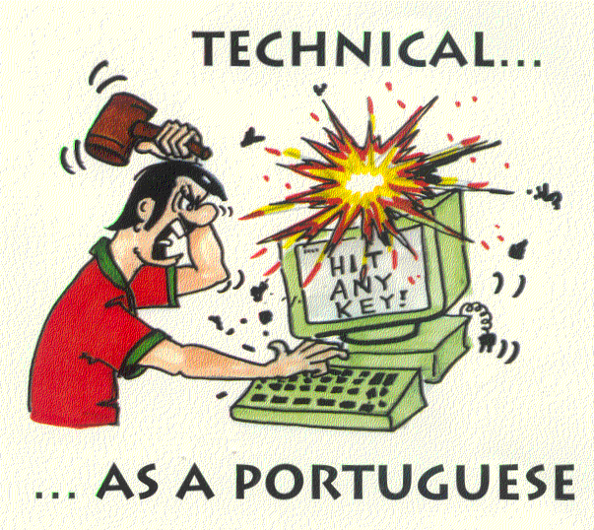
estereótipos

Slide 13
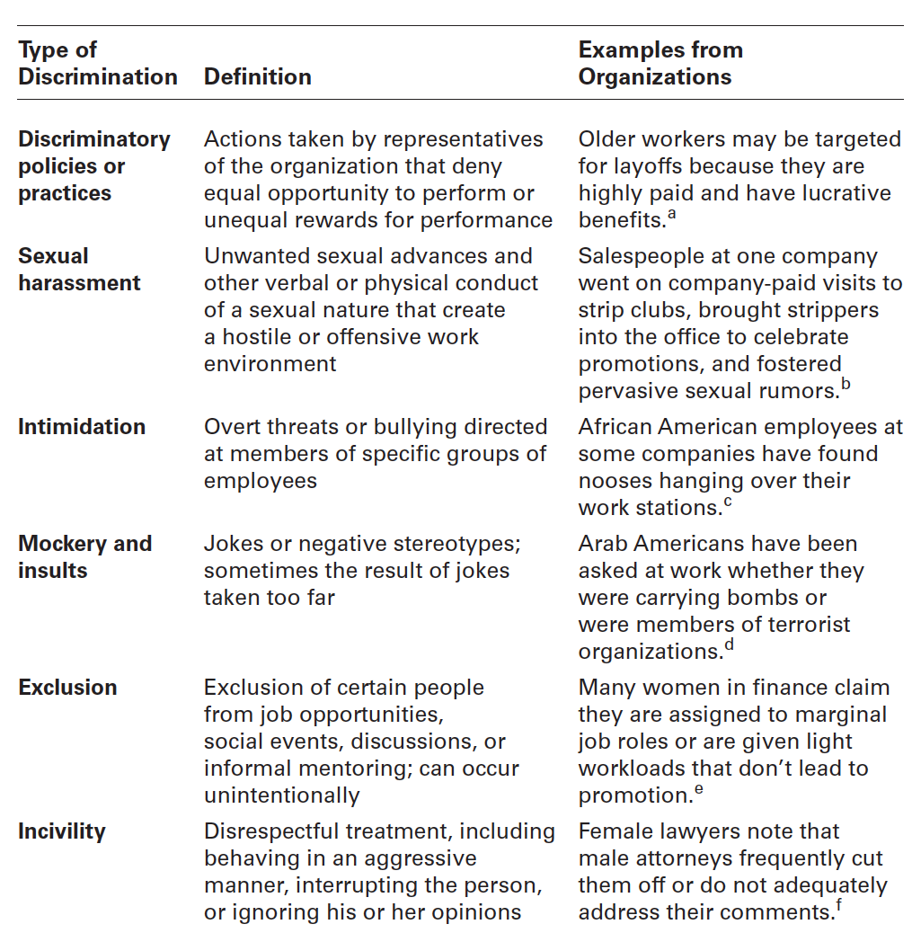
figura 5-7
Formas de Discriminação

Slide 14
Aspetos legais da discriminação
Referências Internacionais
  - Declaração Universal dos Direitos do Homem
  - Convenções da O.I.T. (Org. Internacional do Trabalho)
Referências Europeias
  - Carta Social Europeia
Referências Portuguesas
  - Constituição da República
  - Código do trabalho
Notes:
The fact is that federal laws have contributed to some of the social change we’ve seen over the last 50-plus years. Failure to comply with federal laws, can be costly and damaging to an organization’s bottom line and reputation. It’s important that managers know what they can and cannot do legally and ensure that all employees understand as well.
However, effectively managing workplace diversity needs to be more than understanding and complying with federal laws. Organizations that are successful at managing diversity use additional diversity initiatives and programs.

Slide 15
Ações da gestão de topo
Mentoring – processo pelo qual um membro da organização, com experiência (o mentor), fornece conselhos e orientação a um membro com menos experiência.
Formação em competências relacionadas com a diversidade – formação especializada que visa sensibilizar os colaboradores sobre a importância da diversidade e desenvolver competências que melhorem o seu trabalho, em contexto de diversidade.
Notes:
A sustainable diversity and inclusion strategy must play a central role in decision-making at the highest leadership level and filter down to every level of the company.
Mentoring is a process whereby an experienced organizational member (a mentor) provides advice and guidance to a less-experienced member (a protégé). Mentors usually provide two unique forms of mentoring functions: career development and social support.
The challenge for organizations is to find ways for employees to be effective in dealing with others who aren’t like them. Diversity skills training is specialized training to educate employees about the importance of diversity and teach them skills for working in a diverse workplace.

Slide 16
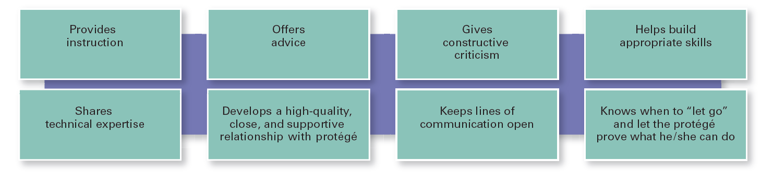
figura 5-9 o que faz um bom mentor?

Slide 17
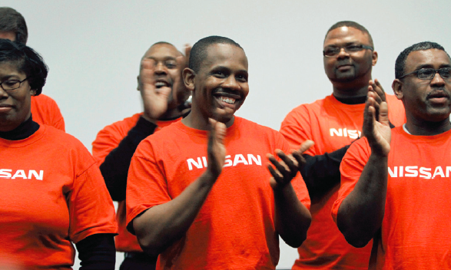
Ações da gestão de topo (cont.)
Grupos de interesse
Grupos formados por empregados que partilham uma determinada dimensão de diversidade.
Notes:
Employee resource groups are made up of employees connected by some common dimension of diversity. Such groups typically are formed by the employees themselves, not the organizations. However, it’s important for organizations to recognize and support these groups.

Slide 18


